Slide 1

Starting out with Python
Fifth Edition
Chapter 10
Classes and Object-Oriented Programming
Copyright © 2021, 2018, 2015 Pearson Education, Inc. All Rights Reserved

Slide 2
Topics
Procedural and Object-Oriented Programming
Classes
Working with Instances
Techniques for Designing Classes

Slide 3
Procedural Programming
Procedural programming: writing programs made of functions that perform specific tasks
  Procedures typically operate on data items that are separate from the procedures
  Data items commonly passed from one procedure to another
  Focus: to create procedures that operate on the program’s data

Slide 4
Object-Oriented Programming (1 of 4)
Object-oriented programming: focused on creating objects
Object: entity that contains data and procedures
  Data is known as data attributes and procedures are known as methods
    Methods perform operations on the data attributes
Encapsulation: combining data and code into a single object

Slide 5
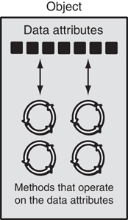
Object-Oriented Programming (2 of 4)
Figure 10-1 An object contains data attributes and methods

Slide 6
Object-Oriented Programming (3 of 4)
Data hiding: object’s data attributes are hidden from code outside the object
  Access restricted to the object’s methods
    Protects from accidental corruption
    Outside code does not need to know internal structure of the object
Object reusability: the same object can be used in different programs
  Example: 3D image object can be used for architecture and game programming

Slide 7
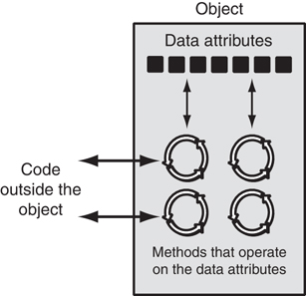
Object-Oriented Programming (4 of 4)
Figure 10-2 Code outside the object interacts with the object’s methods

Slide 8
An Everyday Example of an Object
Data attributes: define the state of an object
  Example: clock object would have second, minute, and hour data attributes
Public methods: allow external code to manipulate the object
  Example: set_time, set_alarm_time
Private methods: used for object’s inner workings

Slide 9
Classes (1 of 3)
Class: code that specifies the data attributes and methods of a particular type of object
  Similar to a blueprint of a house or a cookie cutter
Instance: an object created from a class
  Similar to a specific house built according to the blueprint or a specific cookie
  There can be many instances of one class

Slide 10
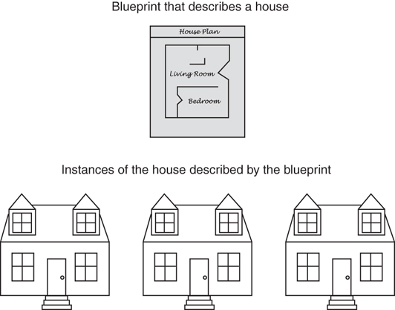
Classes (2 of 3)
Figure 10-3 A blueprint and houses built from the blueprint

Slide 11
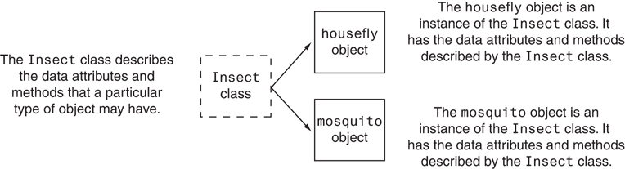
Classes (3 of 3)
Figure 10-4 The housefly and mosquito objects are instances of the Insect class

Slide 12
Class Definitions (1 of 4)
Class definition: set of statements that define a class’s methods and data attributes
  Format: begin with class Class_name:
    Class names often start with uppercase letter
  Method definition like any other python function definition
    self parameter: required in every method in the class – references the specific object that the method is working on

Slide 13
Class Definitions (2 of 4)
Initializer method: automatically executed when an instance of the class is created
  Initializes object’s data attributes and assigns self parameter to the object that was just created
  Format: def __init__ (self):
  Usually the first method in a class definition

Slide 14
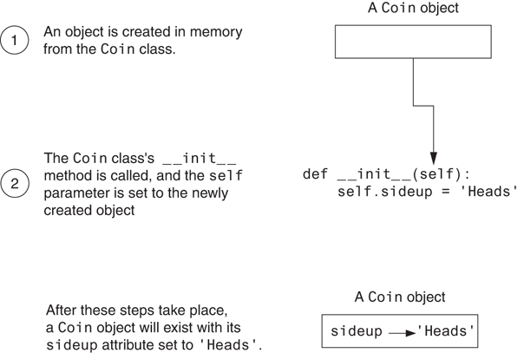
Class Definitions (3 of 4)
Figure 10-5 Actions caused by the Coin() expression

Slide 15
Class Definitions (4 of 4)
To create a new instance of a class call the initializer method
  Format: My_instance = Class_Name()
To call any of the class methods using the created instance, use dot notation
  Format: My_instance.method()
  Because the self parameter references the specific instance of the object, the method will affect this instance
    Reference to self is passed automatically

Slide 16
Hiding Attributes and Storing Classes in Modules
An object’s data attributes should be private
  To make sure of this, place two underscores (__) in front of attribute name
    Example: __current_minute
Classes can be stored in modules
  Filename for module must end in .py
  Module can be imported to programs that use the class

Slide 17
The BankAccount Class – More About Classes
Class methods can have multiple parameters in addition to self
  For __init__, parameters needed to create an instance of the class
    Example: a BankAccount object is created with a balance
      When called, the initializer method receives a value to be assigned to a __balance attribute
  For other methods, parameters needed to perform required task
    Example: deposit method amount to be deposited

Slide 18
The __str__ method
Object’s state: the values of the object’s attribute at a given moment
__str__ method: displays the object’s state
  Automatically called when the object is passed as an argument to the print function
  Automatically called when the object is passed as an argument to the str function

Slide 19
Working With Instances (1 of 3)
Instance attribute: belongs to a specific instance of a class
  Created when a method uses the self parameter to create an attribute
If many instances of a class are created, each would have its own set of attributes

Slide 20
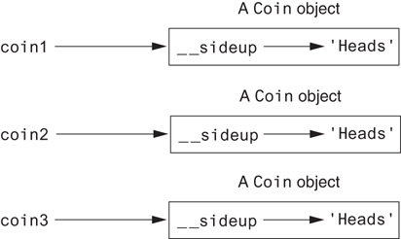
Working With Instances (2 of 3)
Figure 10-7 The coin1, coin2, and coin3 variables reference three Coin objects

Slide 21
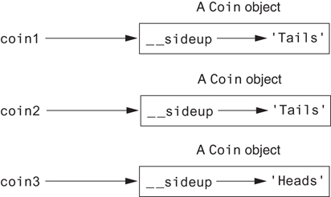
Working With Instances (3 of 3)
Figure 10-8 The objects after the toss method

Slide 22
Accessor and Mutator Methods
Typically, all of a class’s data attributes are private and provide methods to access and change them
Accessor methods: return a value from a class’s attribute without changing it
  Safe way for code outside the class to retrieve the value of attributes
Mutator methods: store or change the value of a data attribute

Slide 23
Passing Objects as Arguments
Methods and functions often need to accept objects as arguments
When you pass an object as an argument, you are actually passing a reference to the object
  The receiving method or function has access to the actual object
    Methods of the object can be called within the receiving function or method, and data attributes may be changed using mutator methods

Slide 24
Techniques for Designing Classes (1 of 3)
UML diagram: standard diagrams for graphically depicting object-oriented systems
  Stands for Unified Modeling Language
General layout: box divided into three sections:
  Top section: name of the class
  Middle section: list of data attributes
  Bottom section: list of class methods

Slide 25
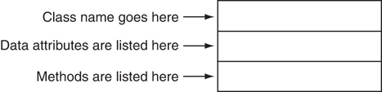
Techniques for Designing Classes (2 of 3)
Figure 10-9 General layout of a UML diagram for a class

Slide 26
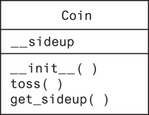
Techniques for Designing Classes (3 of 3)
Figure 10-10 UML diagram for the Coin class

Slide 27
Finding the Classes in a Problem (1 of 4)
When developing object oriented program, first goal is to identify classes
  Typically involves identifying the real-world objects that are in the problem
  Technique for identifying classes:
    Get written description of the problem domain
    Identify all nouns in the description, each of which is a potential class
    Refine the list to include only classes that are relevant to the problem

Slide 28
Finding the Classes in a Problem (2 of 4)
Get written description of the problem domain
  May be written by you or by an expert
  Should include any or all of the following:
    Physical objects simulated by the program
    The role played by a person
    The result of a business event
    Recordkeeping items

Slide 29
Finding the Classes in a Problem (3 of 4)
Identify all nouns in the description, each of which is a potential class
  Should include noun phrases and pronouns
  Some nouns may appear twice

Slide 30
Finding the Classes in a Problem (4 of 4)
Refine the list to include only classes that are relevant to the problem
  Remove nouns that mean the same thing
  Remove nouns that represent items that the program does not need to be concerned with
  Remove nouns that represent objects, not classes
  Remove nouns that represent simple values that can be assigned to a variable

Slide 31
Identifying a Class’s Responsibilities
A classes responsibilities are:
  The things the class is responsible for knowing
    Identifying these helps identify the class’s data attributes
  The actions the class is responsible for doing
    Identifying these helps identify the class’s methods
To find out a class’s responsibilities look at the problem domain
  Deduce required information and actions

Slide 32
Summary
This chapter covered:
  Procedural vs. object-oriented programming
  Classes and instances
  Class definitions, including:
    The self parameter
    Data attributes and methods
    __init__ and __str__ functions
    Hiding attributes from code outside a class
  Storing classes in modules
  Designing classes

